Slide 1
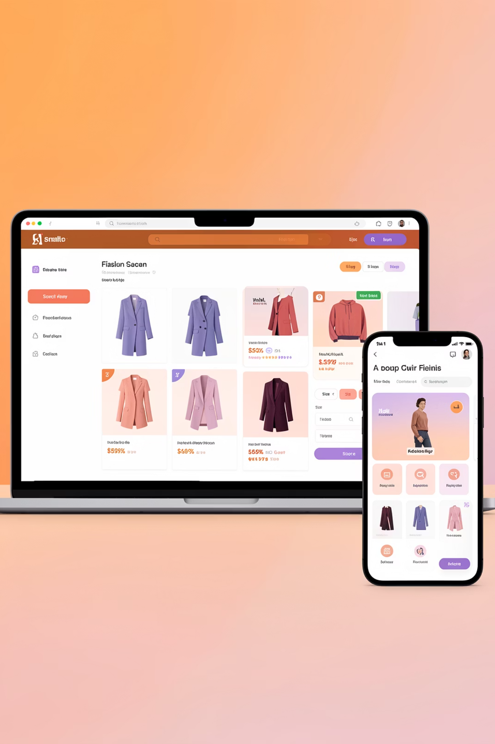
Optimizing Size Recommendations
Reducing Return Rates Through Data-Driven Product Strategy
J Naveen Vignesh
VIT Chennai | ECE (2026)
Product Management Internship Application

Slide 2



The Problem
₹105 Cr
Annual Cost
Size-related returns in fashion e-commerce
35-40%
40%
24.4%
Fashion Return Rate
Are Size-Related
Experience Sizing Issues

Slide 3

Problem Framing: Size Uncertainty at PDP
Customers face high uncertainty when selecting sizes on the Product Detail Page (PDP), leading to incorrect size purchases, exchanges, and returns.
Why current solutions fail:• Static size charts do not account for brand-specific fit variation
• Fit feedback is buried inside long, unstructured reviews
• Customers must manually interpret conflicting signals
• No real-time, confidence-building sizing cue exists at selection
Outcome:Users hedge risk by ordering multiple sizes or exchanging post-purchase.

Slide 4

Competitive Landscape Analysis
Comparison of size recommendation capabilities across major fashion platforms:
Feature
Myntra
Amazon
Ajio
Zara
H&M
Size Guide Visibility
Yes
Yes
Yes
Yes
Yes
Structured Fit Feedback
No
Yes
No
No
No
Size Recommendation
No
Limited
No
No
No
Cross-Brand Comparison
No
No
No
No
No
Key Insight: Only Amazon surfaces structured fit feedback. No platform offers cross-brand size comparison—a clear opportunity for differentiation.

Slide 5
Data Collection Methodology
Categories Analyzed
Metric
Count
1. Men's T-Shirts (10 products)
Products Analyzed
30
Levi's, Adidas, Puma, H&M, Roadster, Mast & Harbour, WROGN
Size Measurements
158
Customer Reviews
90
2. Men's Casual Shirts (10 products)
Brands Covered
9
Cross-brand comparison
3. Women's Tops (10 products)
Categories
4
Multi-category insights

Slide 6
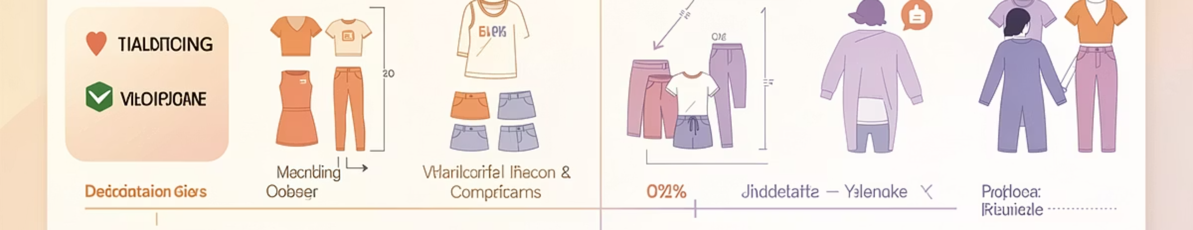
Finding #1: Brand Size Inconsistency
33%
High Variation Brands
Of brands show high size variation (>15% CV)

Slide 7
Finding #2: Customer Sizing Feedback
Brand Accuracy Rankings
Top Performers
Needs Improvement
Highlander: 100%
Levi's: 93.3%
Puma: 88.9%
Roadster: 61.1%
HERE & NOW: 58.3%

Slide 8
Finding #3: Category Comparison
Key Insights
✓ Thermal Category
⚠ Women's Tops
→ T-shirts & Shirts
Achieves 100% accuracy
Lowest accuracy at 67%
Perform equally at 80%

Slide 9
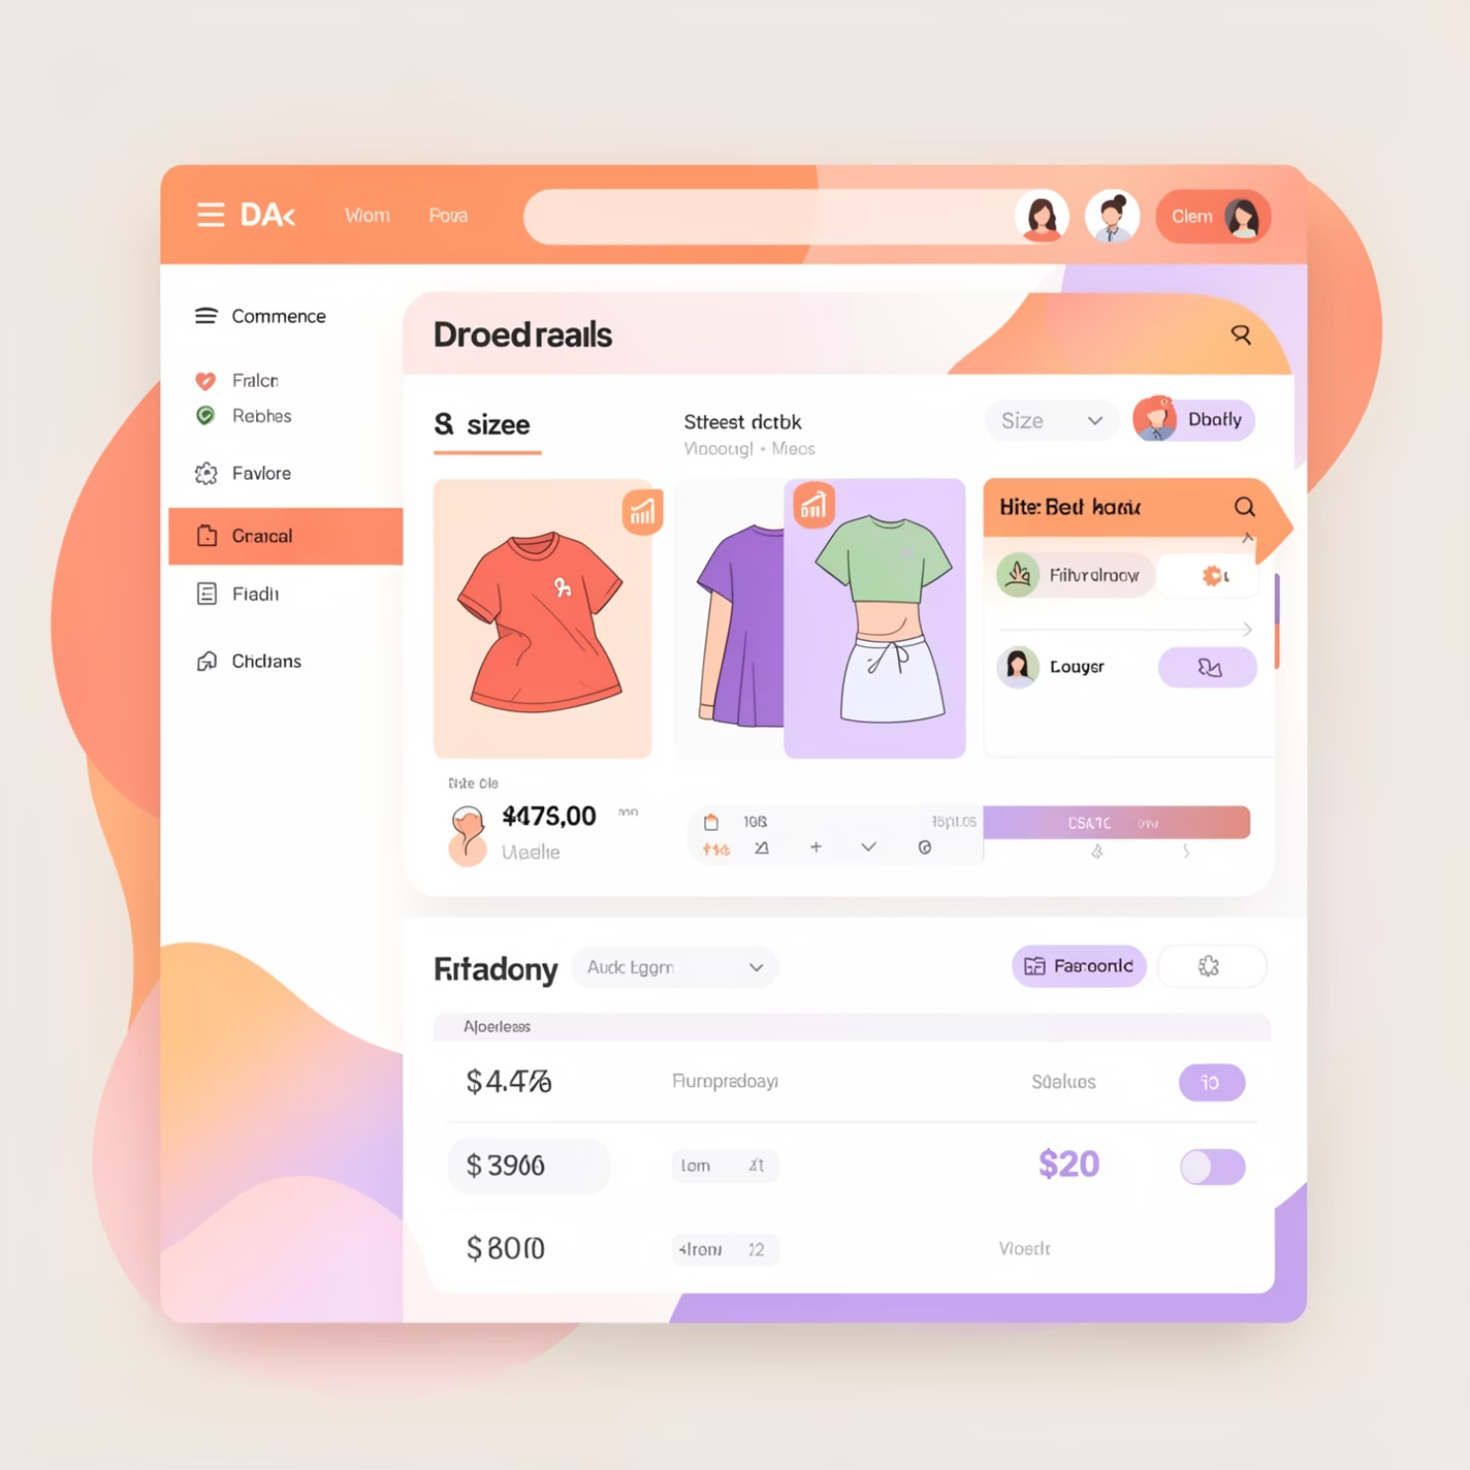
Product Solution: Fit Feedback Badge (MVP)
The Solution
Introduce a "Fit Feedback Badge" on the Product Detail Page that displays aggregated customer fit feedback.
How It Works
Shows: Runs Small / True to Size / Runs Large
Backed by aggregated customer reviews
Displayed inline near size selector
Non-personalized, low-risk MVP approach
Why This MVP
• Uses existing review data, no new infra required
• Non-personalized and low-risk for first rollout
• Improves confidence without changing size selection logic
• Optimized for fast experimentation and iteration

Slide 10


User Flow: Before vs After
Before
After
View static size chart
Scan through reviews manually
Guess best size
High uncertainty
See Fit Feedback Badge inline
Instant fit signal (Runs Small/True/Large)
Select size with confidence
Reduced decision friction
Result:Reduced decision friction at size selection, higher purchase confidence, and lower likelihood of size-related returns.

